Slide 1
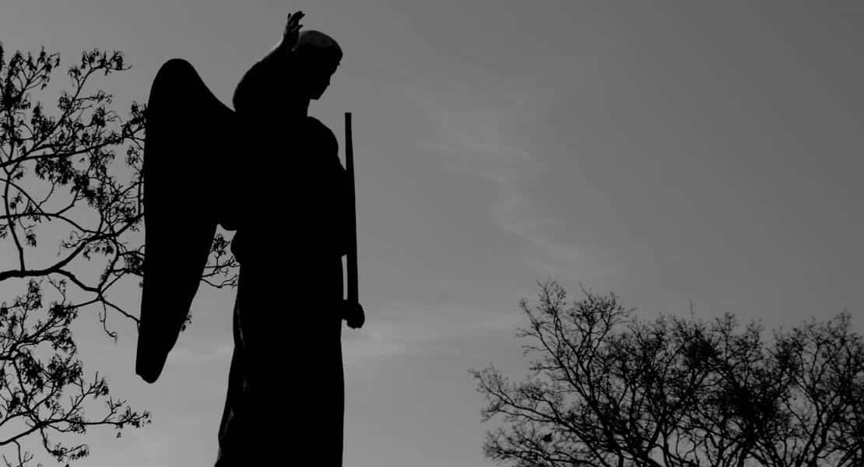
Nashville City Cemetery
By: Hunter Farrar

Slide 2
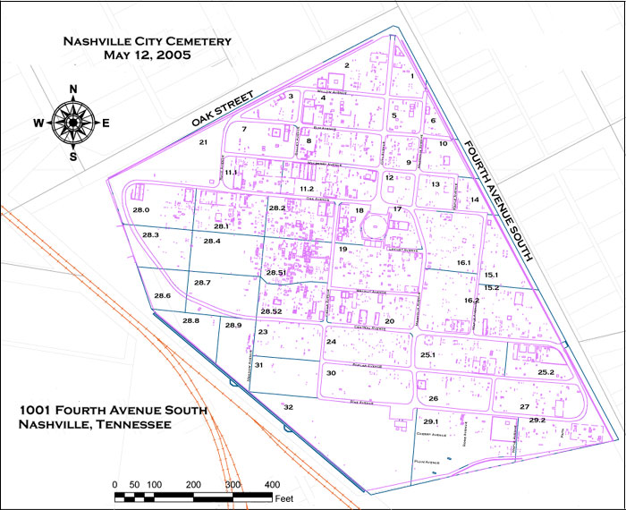
Map of the Cemetery
Pulled from the Nashville City Cemetery website

Slide 3
Fun Facts
Charles Dickinson, famously killed by President Andrew Jackson in a duel, was buried in the Nashville City Cemetery.
The cemetery opened to the public in 1822.
The cemetery holds the graves of fallen soldiers from the American Revolutionary War and the Civil War. Soldiers on both sides of the Civil War were buried there.
The cemetery was restored by Mayor Ben West in 1958, and starting in 1972 was listed as a historic landmark due to its rich history.

Slide 4
Causes of Death
More people have “Unknown” listed as cause of death than any other cause.
Consumption, another word for Tuberculosis, is the second most listed.
Surprisingly Cancer only showed up 133 times.

Slide 5
Spooky Search Categories
100 Club: Find a burial site of someone over the age of 100 (the older the better)
Find someone with your last name
Find the most buried soldiers
Find the most famous people (politicians, war generals, etc.)

Slide 6
Spooky Search
Friday October 31st, 2025 from 7pm – 9pm
Food and Drinks provided
Prizes for top three places in the search

Slide 7
Thank you for your time, and we hope to see you there!

